Slide 1

VIDEO ANALYTICS

Slide 2
PROBLEM STATEMENT:
Banks are using video cameras for the purpose of surveillance at many branches, ATMs and digital lobbies. Getting video analytics of different parameters from the video recording will help the bank to resolve many operational issues at the branches. The bank wants to explore video analytics to understand the customer sentiments, understand the patterns /behaviors/actions in certain branches for proactive surveillance and provide better services to customers.
OBJECTIVE:
•Development of Step-by-Step Form
•Branching of What details to be filled as per the selections.
•Auto fill Repeating Information
•Voice (to support multiple India Languages) and Virtual Keyboard based interactions.
•Clicking Documents with HL camera (Need to understand the process where we can save these documents to
keep them safe after clicking)

Slide 3
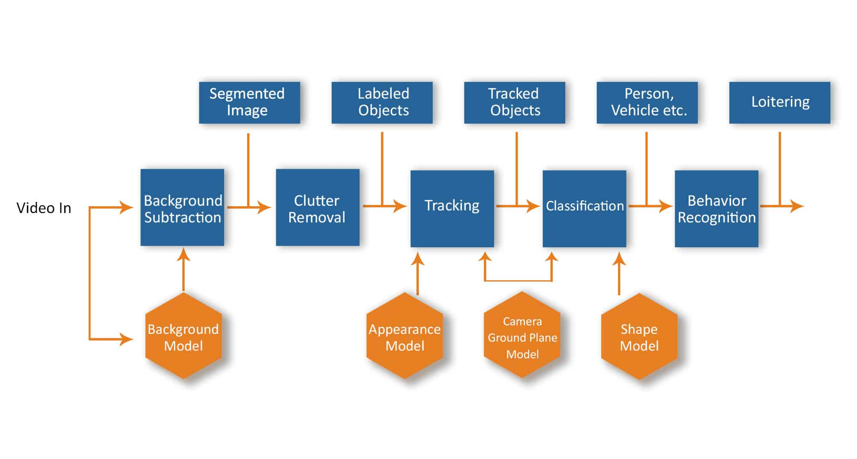
WORKING METHODOLOGY:

Slide 4
CODE TOOLS USED:
VISUAL STUDIO CODE
GOOGLE COLAB
EXISTING SOLUTION:
Video analytics software enables banks and financial institutions to increase safety and situational awareness by harnessing their existing surveillance networks to enable security to respond to events as they unfold as well as search and filter video to accelerate post-event investigations. By aggregating video generated data, finance organizations can extend the value of video to operational and marketing business units, with visibility into behavioral trends and footfall across bank branches in order to drive data-driven decision making around optimizing customer service, building layouts, and security protocols.

Slide 5
SOLUTION:
Banking Video Analytics makes your bank branches and ATMs smart!
Banking Video Analytics makes your bank branches and ATMs smart!
According to the report of the Finance Ministry, there are 2.13 lakh ATMs and innumerable bank branches as of 2021. Security of ATMs and banks is a supremely vulnerable industry in India. There is an ATM in almost every corner of the street in a city in our country but security and maintenance continue to be considerable issues.
There comes the use of AIVIS, the foremost product of Agrex.ai. AIVIS is an AI-enabled camera device that will monitor your branch or ATM facility 24*7.
AIVIS enables banks and financial institutions to increase safety and situational awareness by harnessing their existing surveillance networks to enable security to respond to events as they unfold as well as search and filter video to accelerate post-event investigations. By aggregating video generated data, banking organizations with brick-and-mortar facilities can extend the value of video to operational and marketing business units, with visibility into behavioral trends and footfall across bank branches in order to drive data-driven decision making around optimizing customer service, building layouts, and security protocols.

Slide 6
CONCLUSION:
The main goal of video analytics is to automatically recognize temporal and spatial events in videos. A person who moves suspiciously, traffic signs that are not obeyed, the sudden appearance of flames and smoke; these are just a few examples of what a video analytics solution can detect
One such advancement is intelligent video analytics, a set of computer-vision-based AI technologies that uses deep-learning neural networks to analyze videos and “learn” to identify objects, people, activities, emotions – in real time.

Slide 7
THANK YOU

